Slide 1
BASIC PROFESSIONAL TRAINING COURSE
Module 21-P3
Name of Lecturer
Organization
Email address

Slide 2
BASIC PROFESSIONAL TRAINING COURSE
Leadership, Management for Safety and Safety Culture
Safety Culture
This material was prepared by the IAEA and co-funded by the European Union.

Slide 3
Contents
SF
GSGs
SSRs
GSGs
SSG
Definition and Concept of Safety Culture
IAEA Approach- IAEA Safety Standards
Basic Characteristics of Safety Culture
Assessment of Safety Culture

Slide 4
Learning objectives
Safety Culture
After completing this chapter from Module 21, the trainee will be able to understand:
IAEA safety standards relevant to Safety Culture requirements
Basic understanding on the concept of Safety Culture and assessment of safety culture

Slide 5
Definition and Concept of Safety Culture

Slide 6
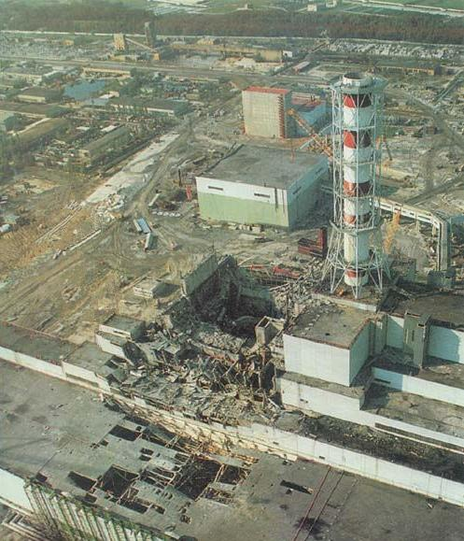
The IAEA Advisory Group INSAG
“A vital conclusion drawn from this behaviour is the importance of placing complete authority and responsibility for the safety of the plant on a senior member of the operations staff of the plant. Of equal importance, formal procedures must be properly reviewed and approved and must be supplemented by the creation and maintenance of a ‘nuclear safety culture’”.
(INSAG-1, 1986)
Chernobyl reactor 4 after the accident
The concept of the safety culture was now formally introduced in the area of nuclear safety.
Notes:
In fact the accident at Chernobyl provided enough thoughts to the nuclear experts to draw conclusion on the importance of placing complete authority and responsibility for the safety of the plant on a senior member of the operations staff of the plant. Of equal importance, formal procedures must be properly reviewed and approved and must be supplemented by the creation and maintenance of a ‘nuclear safety culture’” it was highlighted in the INSAG 1 in 1986 after the Chernobyl accident. The concept of the safety culture was now formally introduced in the area of nuclear safety

Slide 7
The IAEA Advisory Group INSAG
Definition of safety culture
“Safety Culture is that assembly of characteristics and attitudes in organizations and individuals which establishes that, as an overriding priority, protection and safety issues receive the attention warranted by their significance”.
(2016 IAEA glossary)
Notes:
Definition of the safety culture was introduced by the IAEA the first time in the INSAG-4 after Chernobyl accident. To highlight the protection issues, the definition was modified in 2007
[From INSAG-4; INSAG-7 |5.7] In its report on the Chernobyl accident, INSAG coined the term 'safety culture' to refer to the safety regime that should prevail at a nuclear plant. In both operating and regulatory regimes, safety culture must be instilled in organizations through proper attitudes and practices of management. Safety culture continues to be an important issue based on lessons learned from the Fukushima Daiichi accident.
The concept of the safety culture was now formally introduced in the area of nuclear safety. [From IAEA Safety Glossary] Safety culture is defined as that assembly of characteristics and attitudes in organizations and individuals which establishes that, as an overriding priority, nuclear plant safety issues receive the attention warranted by their significance.[From INSAG-13 |7] The safety management system comprises those arrangements made by the organization for the management of safety in order to promote a strong safety culture and achieve good safety performance. [From INSAG-13 |8] One of the two general aims of the safety management system is to foster and support a strong safety culture through the development and reinforcement of good safety attitudes and behaviour in individuals and teams so as to allow them to carry out their tasks safely.

Slide 8
IAEA Approach- IAEA Safety Standards

Slide 9
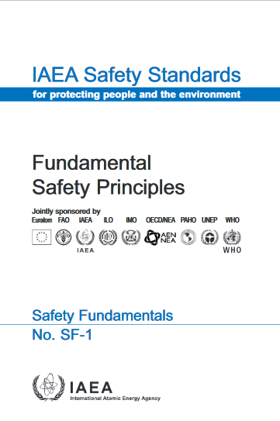
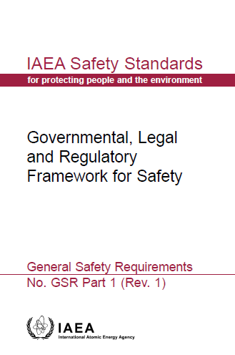
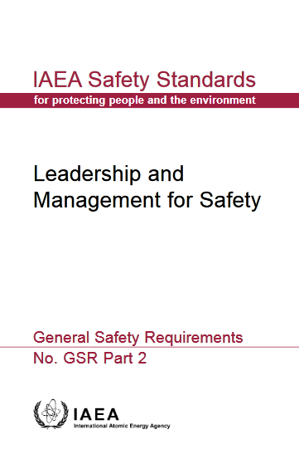
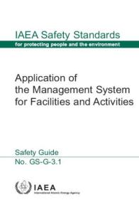
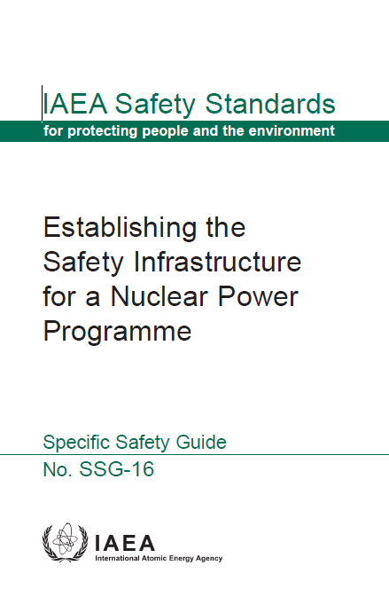
Relevant IAEA Safety Standards
Notes:
These documents discuss the fundamentals and requirements of safety culture and its continuous improvement and provide guidance for the implementation

Slide 10
Fundamental Safety Principles SF-1
Principle 3: Leadership and management for safety
  3.12. “…The management system has to integrate all elements of management...., including those for human performance, quality and security,.... The management system also has to ensure the promotion of a strong safety culture”
Integration of Safety Culture in Management System
    3.13. A safety culture that governs the attitudes and behaviour in relation to safety of all organizations and individuals concerned must be integrated in the management system
  Safety culture includes:
      Individual and collective commitment to safety on the part of the leadership, the management and personnel at all levels
      .....encourage a questioning and learning attitude and to discourage complacency with regards to safety
Notes:
Integrated management systems
Principle 3: Leadership and management for safety
3.12. This system has to integrate all elements of management so that safety is not compromised by other requirement or demands.
The management system also has to ensure the promotion of a strong safety culture…”
Integration of Safety Culture in Management System
Safety culture includes:
Individual and collective commitment to safety and to encourage a questioning and learning attitude and to discourage complacency with regards to safety

Slide 11
GSR Part 1: National Policy and Strategy
Requirement 1: National policy and strategy for safety
  2.3 (g): “The promotion of leadership and management for safety, including safety culture.”
Requirement 19: The management system of the regulatory body
  4.15. The management system of the regulatory body has three purposes: … (3) The third purpose is to foster and support a safety culture in the regulatory body through the development and reinforcement of leadership, as well as good attitudes and behaviour in relation to safety on the part of individuals and teams
Requirement 29: Graded approach to inspections of facilities and activities
  4.53. In conducting inspections, the regulatory body shall consider a number of aspects, including: Management systems and safety culture
Notes:
GSR part 1 presents several requirements related to safety culture

Slide 12
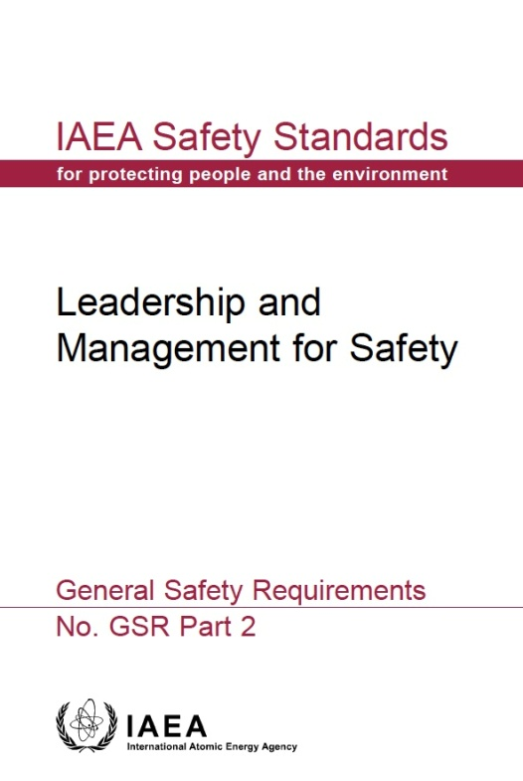
GSR Part 2 Leadership & Management for Safety
R1: Achieving the fundamental safety objective
Responsibility for Safety
Responsibility for Integration of Safety into the Management System
R2: Demonstration leadership for safety by managers
Leadership for Safety
Culture for Safety
R12: Fostering a culture for safety
Management for Safety
R3: Responsibility of Senior Management for the Management System
Measurement, Assessment and Improvement
R13: Measurement, assessment and improvement of the management system
R4: Goals, strategies, plans and objectives
R14: Measurement, assessment and improvement of the management system
R5: Interaction with interested parties
Management of Processes and Activities
R6: Integration of the Management System
R7: Application of the Graded Approach
R8: Documentation of the Management System
The Management System
Management of Resources
R9: Provision of Resources
R10: Management of Processes and Activities
R11: Management of the Supply Chain
Management of Processes and Activities
07-18 May - 18-29 June 2018
Notes:
2. RESPONSIBILITY FOR SAFETY
Requirement 1: Achieving the fundamental safety objective
3. LEADERSHIP FOR SAFETY .
Requirement 2: Demonstration of leadership for safety by managers
4. MANAGEMENT FOR SAFETY
Responsibility for integration of safety into the management system
Requirement 3: Responsibility of senior management for the management system
Requirement 4: Goals, strategies, plans and objectives
Requirement 5: Interaction with interested parties
Requirement 6: Integration of the management system
Requirement 7: Application of the graded approach to the management system
Requirement 8: Documentation of the management system
Management of resources
Requirement 9: Provision of resources
Management of processes and activities
Requirement 10: Management of processes and activities
Requirement 11: Management of the supply chain
5. CULTURE FOR SAFETY
Requirement 12: Fostering a culture for safety
6. MEASUREMENT, ASSESSMENT AND IMPROVEMENT
Requirement 13: Measurement, assessment and improvement of the management system
Requirement 14: Measurement, assessment and improvement of leadership for safety and of safety culture

Slide 13
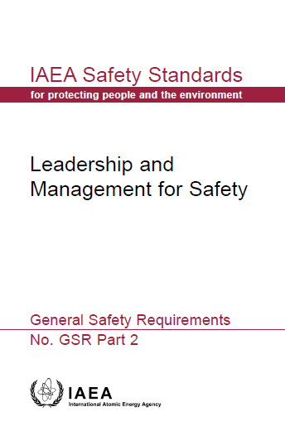
GSR Part 2: Requirements on Safety Culture
Requirement 12: Fostering a culture for safety
  “Individuals in the organization, from senior managers downwards, shall foster a strong safety culture. The management system and leadership for safety shall be such as to foster and sustain a strong safety culture.”
  5.1. All individuals in the organization shall contribute to fostering and sustaining a strong safety culture
  5.2. Senior managers and all other managers shall advocate and support :
    common understanding of safety culture
    organization supports individuals in carrying out
    their tasks, taking into account the ITO
    learning and questioning attitude at all levels of
    the organization
    develop and improve its safety culture
Notes:
The fostering of a strong safety culture starts with the senior management

Slide 14
GSR Part 2: Requirements on Safety Culture
Requirement 14: Measurement, assessment and improvement of leadership for safety and of safety culture
“Senior management shall regularly commission assessments of leadership for safety and of safety culture in its own organization”.
6.9. Senior management shall ensure that self-assessment of safety culture includes assessment at all organizational levels and for all functions in the organization using recognized experts for the assessment.
6.10. Senior management shall ensure that an independent assessment of safety culture is conducted for enhancement of the organizational culture for safety
6.11. The results of assessments of safety culture shall be communicated at all levels in the organization. The results of such assessments shall be acted upon to foster and sustain a strong safety culture and a learning attitude within the organization
Notes:
Requirement 14 and the related supporting requirements 6,9, 6.10 and 6.11 requires the measurement and continuous improvement of the safetu culture.

Slide 15
SSG 16 Recommendations
  Phase 1
    Action 72. The government should take into account
    the essential role of leadership and management for
    safety to achieve a high level of safety and to foster
    safety culture within organizations
Phase 2
  Action 75: The regulatory body and the operating organization should start developing and implementing effective management systems in their respective organizations and should promote a strong safety culture.
Phase 3
  Action 78: The senior management of all the relevant organizations should provide effective leadership and effective management for safety to ensure a sustainable high level of safety and a strong safety culture.
Notes:
SSG provides detailed overview of the actions to be performed by an organization (including the government and the regulatory body) which safety requirements/guidance are to be implemented in which phase of building the nuclear infrastructure. And the presented actions discusses the safety culture aspects

Slide 16
IAEA Safety Culture Publications
IAEA Safety Culture Publications http://www.iaea.org
Safety Fundamentals No. SF-1 | Fundamental Safety Principles
Safety Requirements No GSR Part 2 | Leadership and Management for Safety
Safety Guide No. GS-G-3.1 | Application of the Management System for Facilities and Activities
Safety Guide No. GS-G-3.5 | The Management System for Nuclear Installations
Safety Series No. 75-INSAG-4 | Safety Culture
Safety Series No. 75-INSAG-15 | Key Practical Issues in Strengthening Safety Culture
Safety Report Series No. 11 | Developing Safety Culture in Nuclear Activities
Safety Report Series No. 42 | Safety Culture in the Maintenance of Nuclear Power Plants
Safety Report Series: No 74 | Safety Culture during Pre-Operational Phases – Published Sept 2012
Safety Report Series | How to Perform Safety Culture Self-Assessment - draft
Safety Report Series | How to Continuously Improve Safety Culture - draft
TECDOC-1321 | Self-assessment of safety culture in nuclear installations
TECDOC-1329 | Safety culture in nuclear installations
TECDOC-1707 | Regulatory Oversight of Safety Culture In Nuclear Installations

Slide 17
Basic Characteristics of Safety Culture

Slide 18
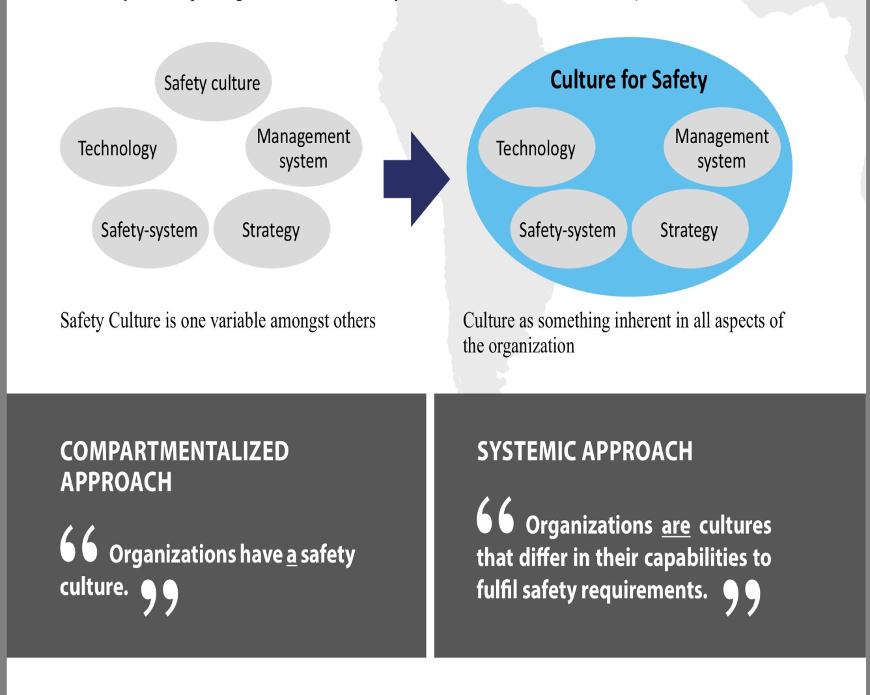
GSR Part 2: Safety Culture
Achieving the fundamental safety objective
Concept of Safety Culture vs
Culture for Safety
Leadership for Safety
Process Implementation
Measurement, Assessment and Improvement
Responsibility of Management
Management of Resources
Safety Culture
Effective management for safety consideration of ITO
Organizations have Safety Culture as one variable
Culture is inherent in all aspects of the organization to fulfil safety requirements
07-18 May - 18-29 June 2018
Notes:
GSR Part 2 scope has been extended to cover the ‘three pillars’ of Management for Safety: Leadership for Safety; Safety Culture; Effective Management System
The five general principles used in the Culture of Safety model are:
Informed culture: Informed culture allows an organization to collect and analyze data to stay informed. It creates a system that will be able to circulate information on incidents and near misses while being proactive on safety checks
reporting culture: Reporting culture encourages employees to be open to report safety problems with the assurance that information will be addressed. Employees will maintain confidentiality and will not be penalized for reporting.
just culture: Just culture means employees understand they will be treated fairly and unintentional errors or acts that are unsafe will not be punished.
learning culture: Learning culture is when organizations learn from their mistakes and makes changes as necessary. and
flexible culture: Flexible culture is when an organization is able to make changes to their operations after an incident or near miss.

Slide 19
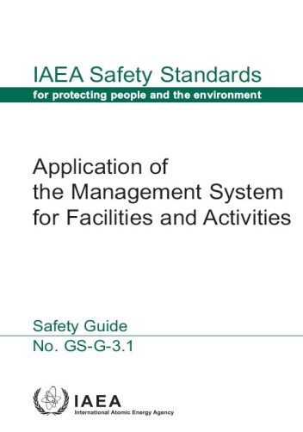
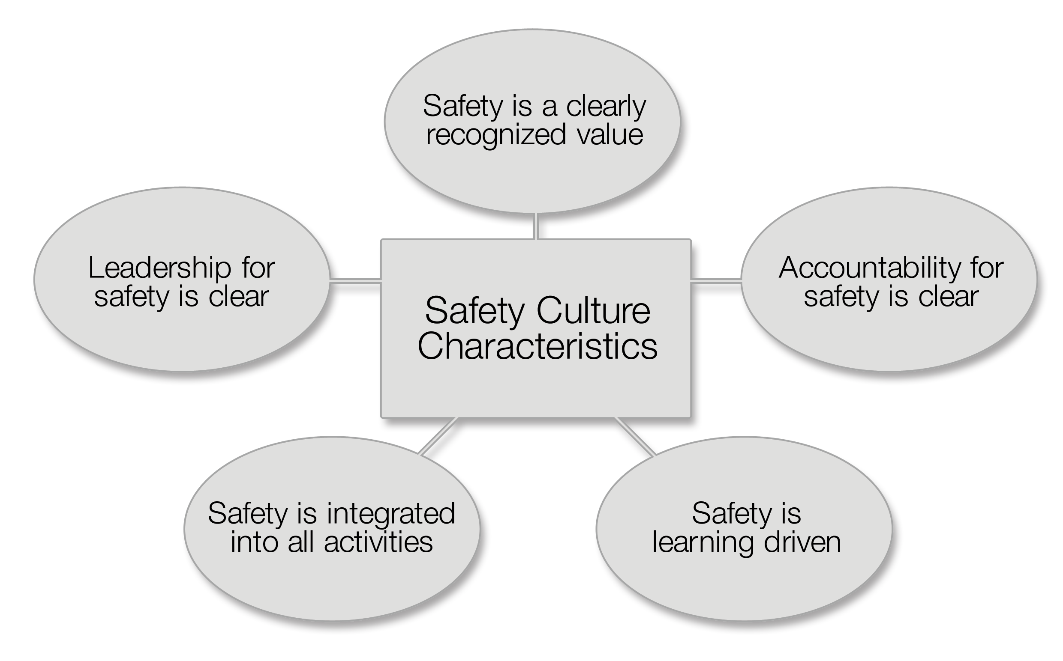
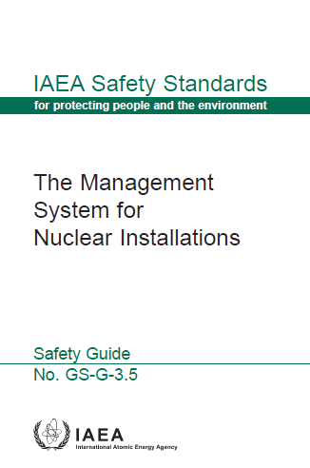
Characteristics and Attributes for Strong Safety Culture
Five key characteristics of safety culture, broken down into attributes, has gradually emerged
Notes:
19
The IAEA defined 5 safety culture characteristics and guidance on these characteristics and the implementation can be found in the presented safety guides.
[From GS-G-3.5 |para 2.14; TECDOC-1329; TECDOC-1707 |2.1.3] Broad agreement on five key characteristics of safety culture has gradually emerged and provide a framework for developing a common understanding of the safety culture concept. The five characteristics are broken down into attributes that further describe important cultural aspects and provide a more detailed framework.

Slide 20
Characteristics and Attributes for Strong Safety Culture
Safety is a clearly recognized value High priority to safety in documentation, communications and decision- making and primary consideration is given in the allocation of resources. Individuals are convinced that safety and production go ‘hand in hand’. A proactive and long-term approach to safety issues is shown in decision-making and a safety conscious behavior is socially accepted and supported
Accountability for safety is clear Appropriate relationship with the regulatory body exists, which ensures that the accountability for safety remains with the licensee, a high level of compliance with regulations and procedures. Roles, responsibilities and accountabilities are clearly defined and understood. Ownership for safety is evident at all organizational levels and by all individuals
Safety is learning driven:
      A questioning attitude prevails at all organizational levels, reporting of errors is encouraged. Assessments, are regularly conducted including operating experience feedback for improvement. Learning is enabled through the ability to recognize deviations and implement solutions and use safety performance indicators for trending, evaluation and improvement.
Notes:
1. Safety is a clearly recognized value: attribute
High priority to safety is shown in documentation, communications and decision- making
Safety is given a primary consideration in the allocation of resources
The strategic business importance of safety is reflected in business plan
Individuals are convinced that safety and production go ‘hand in hand’
A proactive and long-term approach to safety issues is shown in decision-making
Safety conscious behavior is socially accepted and supported (both formally and informally)
2. Accountability for safety is clear
Appropriate relationship with the regulatory body exists, which ensures that the accountability for safety remains with the licensee.
Roles and responsibilities are clearly defined and understood
There is a high level of compliance with regulations and procedures
Management delegates responsibilities with appropriate authority to enable accountabilities
Ownership for safety is evident at all organizational levels and by all individuals
3. Safety is learning driven:
A questioning attitude prevails at all organizational levels
An open reporting of deviations and errors is encouraged
Internal and external assessments, including self-assessments are used
Organizational and operating experience (both internal and external to the facility) is used
Learning is enabled through the ability to recognize and diagnose deviations, formulate and implement solutions and monitor the effects of corrective actions
Safety performance indicators are tracked, trended, evaluated and acted upon
There is a systematic development of staff competencies

Slide 21
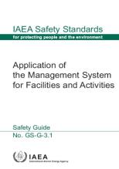
Characteristics and Attributes for Strong Safety Culture
    4. Safety is integrated into all activities Consideration of quality, safety and security is evident including trust, motivation, commitment to excellence and job satisfaction which prevails in the organization. Quality of processes, from planning to implementation and assessment is managed. Individuals have the necessary knowledge and understanding of the work processes, good working conditions exist with regards to time pressures, work load and stress.
5. Leadership of safety is clear Senior management is clearly committed to safety which is evident at all management levels showing their involvement in safety related activities. Leadership competence and skills are systematically developed and sustained. Safety implications are considered in the change management process. Management shows a continuous effort to strive for openness and good communications, ability to resolve conflicts as necessary and relationships between management and staff are built on trust
  Specific guidance for nuclear installations Further explanation of the five safety culture characteristics and the attributes provides insight on improving safety culture by conducting assessment. Concept of ITO.
Notes:
4. Safety is integrated into all activities: attributes
Trust permeates the organization
Consideration for all types of safety, including industrial and environmental safety and security, is evident
Quality of documentation and procedures is good
Quality of processes, from planning to implementation and review, is good
Individuals have the necessary knowledge and understanding of the work processes
Factors affecting work motivation and job satisfaction are considered
Good working conditions exist with regards to time pressures, work load and stress
Cross-functional and interdisciplinary cooperation and teamwork are present
Housekeeping and material condition reflect commitment to excellence
5. Leadership of safety is clear: attributes
Senior management is clearly committed to safety
Commitment to safety is evident at all management levels
Visible leadership showing involvement of management in safety related activities
Leadership skills are systematically developed
Management assures that there is sufficient and competent staff
Safety implications are considered in the change management process
Management shows a continuous effort to strive for openness and good communications
Management has the ability to resolve conflicts as necessary and relationships between management and staff are built on trust
Complacency is often a precursor to a serious decline in safety culture. The management system should have in place the mechanisms by which managers are kept up to date with the warning signs that have been shown to precede organizational failures

Slide 22
Assessment of Safety Culture

Slide 23
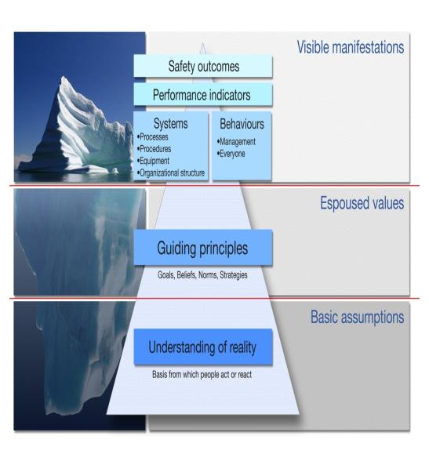
Assessment of Safety Culture
Iceberg model presented by Schein [ref. Tecdoc 1707]
How do we move from observations above the surface
to images of what the culture is like, under the surface?
Based on:
IAEA Safety Standards (GSG 3.5, GSG 3.1)
Behavioural science
Past experiences
Objective of Safety Culture Assessment
The purpose of the safety culture self-assessment is to identify behaviors, attitudes, underline believes and basic assumptions in relation to safety for continuous improvement of organizational safety culture
Notes:
[From IAEA TecDoc-1707 |2.1.2]A three-level model for understanding the culture of any organization has been developed as depicted in the figure. These levels go from the very visible (conscious) to the tacit and invisible (unconscious) ones:
1. ‘Artefacts’ is the easiest level to observe: what you see, hear and feel;
2. ‘Espoused values’ are adopted and supported by a person or organization;
3. ‘Basic assumptions’ lie at the deepest level of culture. They are fundamental beliefs that are so taken for granted that most people in a cultural group subscribe to them without consciously thinking about it.
Safety culture is independent of people who are currently part of the organization. The culture will exist even after the replacement of all the individuals with the newcomers by overlapping through knowledge management and safety culture management; and it is only possible when the basis of the visible artifacts/manifestation is deeply rooted in all espoused values and basic assumptions.

Slide 24
IAEA Assessment Methodology
Assessment of Safety Culture
Using several assessment methods
  (survey or questionnaire, interview, document review, observation, focus group)
Separation of descriptive and normative
Performed in silos – each assessment method treated separate
Descriptive
Normative
‘is’
Based on data and a theory of culture
‘should’
Based on data, a theory of culture and a norm
Survey
Interviews
Focus
groups
Observations

Slide 25
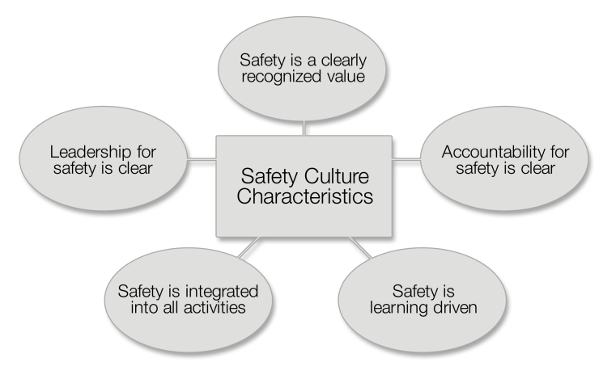
Core of IAEA Safety Culture Analysis Process e. g. Self-assessment or independent assessment
Final Issues; Normative,
evaluative analysis
Overarching themes: Image(s) of culture
Cultural themes
Cultural themes
Cultural themes
Cultural themes
Cultural themes
Cultural facts
Cultural facts
Cultural facts
Cultural facts
Cultural facts
Interview data
Survey data
Focus group data
Document data
Observation data
Notes:
UPD OCT2012

Slide 26
Summary
    The management system and leadership for safety shall be such as to foster and sustain a strong safety culture.
    GSR Part 2 provides that safety culture is recognized as systemic approach to the whole range of interactions of individuals with the technology and the organization ITO concept.
SSG 16- Leaders of the regulatory body and operating organizations should have an attitude to foster safety culture in their respective organizations;
GS-G 3.1 & 3.5 Presents the five key characteristics of safety culture, broken down into attributes
    SCSA uses five methods of data gathering to capture a wide range of cultural expressions
07-18 May - 18-29 June 2018
Notes:
[From SF-1 |Principle 3, 3.13] Safety culture includes: individual and collective commitment to safety on the part of the leadership, the management and personnel at all levels; accountability of organizations and of individuals at all levels for safety; and measures to encourage a questioning and learning attitude and to discourage complacency with regard to safety.
[From GS-G-3.5 |2.8] Any effort to focus attention on developing or improving the safety culture of an organization should rely on a common understanding of the concept of safety culture. Safety culture is that type of organizational culture where safety is of utmost priority, considered essential for the long term success of the organization. The issue is to make that safety culture strong and sustainable, so that safety becomes a prime responsibility or main focus for all types of activity.
[From DS 472 |Para 3.4] A strong safety culture does not grow by itself; it should be fostered and sustained. The behavior and commitment of leaders to safety influences the attitudes and behaviours of individuals. Therefore, a strong safety culture needs the strong commitment and engagement of senior management, with the support of the integrated management system, as [From SF-1 |Principle 3, 3.13] a safety culture governs the attitudes and behaviour in relation to safety of the organization and individuals.
GSR Part 2 §2.6 R12 Fostering a culture of safety. All individuals in the organization, from senior managers downwards, shall contribute to fostering and sustaining a strong safety culture.

Slide 27
Key Points
Definition of the safety culture was introduced by the IAEA the first time in the INSAG-4 after Chernobyl and modified in 2007 taking into account protection issues;
Safety culture continues to be an important issue based on lessons learned from the Fukushima Daiichi accident.
One of the two general aims of the safety management system is to foster and support a strong safety culture through the development and reinforcement of good safety attitudes and behaviour in individuals and teams so as to allow them to carry out their tasks safely.
Safety culture is defined as that assembly of characteristics and attitudes in organizations and individuals which establishes that, as an overriding priority, nuclear plant safety issues receive the attention warranted by their significance.

Slide 28
Questions 10-15 minutes discussion
Define Safety Culture.
What is systemic approach to safety?
What are the 5 characteristics for a Strong Safety Culture?
Name the 5 methods for conducting safety culture self assessment
07-18 May - 18-29 June 2018
Notes:
Review questions for 10-15 minutes discussion :
Q1. Define Safety Culture.
Ans: Safety culture is defined as that assembly of characteristics and attitudes in organizations and individuals which establishes that, as an overriding priority, nuclear plant safety issues receive the attention warranted by their significance.
Q2. What is systemic approach to safety?
Ans: Systemic approach to safety means an approach relating to the system as a whole in which the interactions between individual, technology and organizational factors are duly considered
Q3. What are the 5 characteristics for a Strong Safety Culture?
Ans:
1. Safety is a clearly recognized value
2. Accountability for safety is clear
3. Safety is learning driven
4. Safety is integrated into all activities
5. Leadership of safety is clear
Q4. Name the 5 methods for conducting safety culture self assessment
Ans: Survey or Questionnaire, Interview, Document Review, Observation, Focus Group

Slide 29
List of abbreviations
IMS- Integrated Management System
INSAG – International Nuclear Safety Advisory Group
GSR – General Safety Requirement
GSG – General Safety Guide
SSG – Specific Safety Guide
SCSA – Safety Culture Self Assessment
07-18 May - 18-29 June 2018

Slide 30
References
INTERNATIONAL ATOMIC ENERGY AGENCY, Fundamental Safety Principles, Safety Standards Series No. SF-1, IAEA, Vienna (2006).
INTERNATIONAL ATOMIC ENERGY AGENCY, Governmental, Legal and Regulatory Framework for Safety, IAEA Safety Standards Series No. GSR Part 1 (Rev. 1), IAEA, Vienna (2016).
INTERNATIONAL ATOMIC ENERGY AGENCY, Safety Requirements No. GSR Part 2, Leadership and Management for Safety (2016).
INTERNATIONAL ATOMIC ENERGY AGENCY, Application of the Management System for Facilities and Activities, Safety Guide No. GS-G-3.1, IAEA, Vienna (2006).
INTERNATIONAL ATOMIC ENERGY AGENCY, The Management System for Nuclear Installations, Safety Guide No. GS-G-3.5, IAEA, Vienna (2009).
07-18 May - 18-29 June 2018

Slide 31
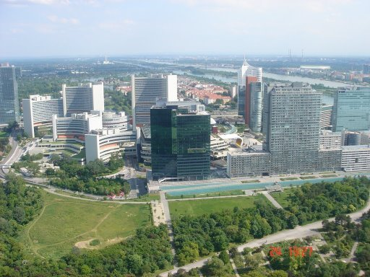
Thank you!

